Slide 1

Manufacturing Analytics
Presented By –
Prathamesh Chinchole
Pratik More
Nikita Deshmukh
Isha Deol
Vishal Vishwakarma
Swapnil Vishwakarma
Eathakota Praveen

Slide 2
Introduction
Domain: Manufacturing Analytics
Manufacturing industries generate large amounts of production, quality, machine, and operational data. Manufacturing analytics helps organizations:
Improve production efficiency
Reduce rejection and wastage
Monitor machine utilization
Improve delivery performance
Optimize manufacturing cost
This project focuses on analyzing manufacturing production data using Excel, SQL, Power BI, and Tableau to identify operational insights and improve decision-making.

Slide 3
Data Overview
Dataset Source:
Manufacturing Production Dataset
Dataset Type:
Excel File
Main Tables Used:
fact_Production, dim_Machine, dim_Department, dim_Employee, dim_Item, dim_Date
Key Fields:
Produced_Qty
Rejected_Qty
Efficiency_Rate_Pct
Machine_Utilization_Pct
Delivery_Status
Total_Value
Per_Day_Machine_Cost

Slide 4
Objectives
Project Objectives
Calculate overall manufacturing efficiency
Analyze rejection percentage
Study machine utilization performance
Analyze department-wise production
Monitor delivery performance
Identify top-performing machines
Create interactive dashboards for analysis

Slide 5
Process
Project Workflow
Collected manufacturing production dataset
Cleaned missing and invalid data in Excel
Imported dataset into SQL
Performed KPI calculations using SQL queries
Connected data to Power BI and Tableau
Built interactive dashboards and visualizations
Analyzed trends and generated insights
Tools Used:
Excel
MySQL
Power BI
Tableau

Slide 6
Overall Manufacturing Performance
KPIs
Total Produced Quantity: 60,050,621
Total Rejected Quantity: 491,023
Average Efficiency Rate: 100.98%
Average Machine Utilization: 83.26%
Average Rejection Rate: 0.83%
Insights:
Manufacturing efficiency is strong across operations
Low rejection percentage indicates better quality control
High machine utilization improves production output
Efficient production reduces operational cost

Slide 7
Conclusion
Manufacturing analytics improves operational efficiency
Machine utilization strongly impacts production output
Low rejection rate improves product quality
Delivery performance affects customer satisfaction
Data analytics helps organizations improve productivity and reduce cost

Slide 8
Challenges & Learnings
Challenges:
Handling large manufacturing datasets
Cleaning inconsistent production records
Calculating KPIs and performance metrics
Building interactive dashboards
Managing production analysis across departments
Learnings:
Data cleaning is very important
Visualization simplifies business insights
Machine performance impacts productivity
Manufacturing operations are highly data-driven

Slide 9
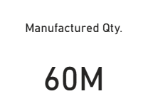
Total Manufactured Quantity
Insight
Total manufactured quantity is 60M units, showing a very high production volume.
This indicates strong manufacturing capacity and operational efficiency.
The KPI helps track overall production performance in the manufacturing process

Slide 10
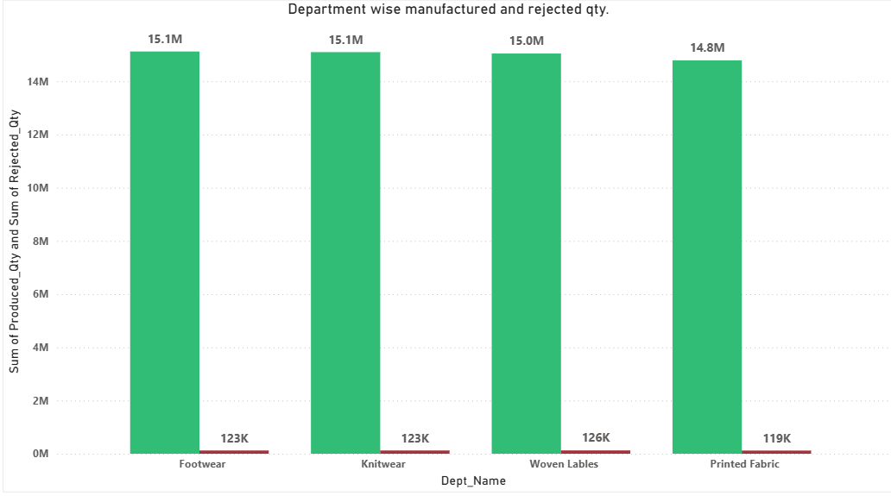
Manufactured Vs Rejected Quantity
Insight
Footwear and Knitwear departments have the highest manufactured quantity (15.1M each).
Woven Labels has the highest rejected quantity (126K), indicating more quality issues.
Printed Fabric has the lowest production (14.8M) and lowest rejection quantity (119K)

Slide 11
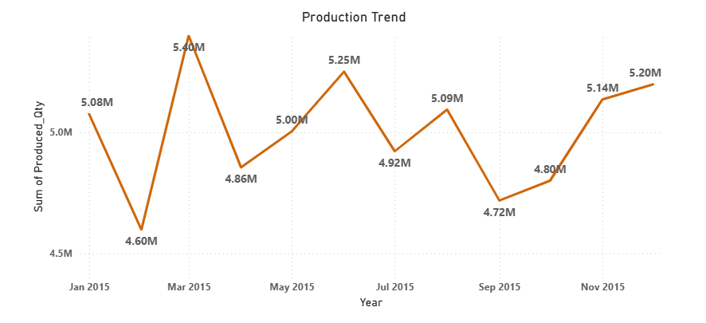
Production Trend
Insight
Production reached its highest point in March 2015 with 5.40M units.
The lowest production was recorded in February 2015 at 4.60M units.
Production fluctuated throughout the year but showed recovery towards the end, reaching 5.20M in December 2015.

Slide 12
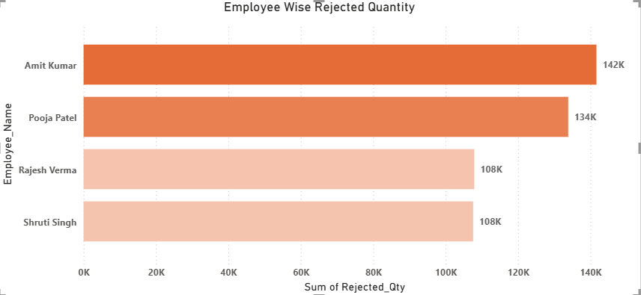
Employee Wise Rejected Quantity
Insight
Amit Kumar has the highest rejected quantity (142K).
Pooja Patel is the second highest with 134K rejections.
Rajesh Verma and Shruti Singh have the lowest and equal rejected quantity (108K).

Slide 13
DELIVERY PERFORMANCE
✅ Early
33.85%
3,385 orders delivered ahead of schedule
🕐 On Time
33.21%
~3,321 orders delivered on the committed date
🚨 Late
32.94%
~3,294 orders missed deadline — critical issue

Slide 14
PRODUCTION ANALYSIS
Printed Fabric
14.8M
Share: 24.5%
Woven Lables
15.0M
Share: 24.8%
Knitwear
15.1M
Share: 25.0%
Footwear
15.1M
Share: 25.0%

Slide 15
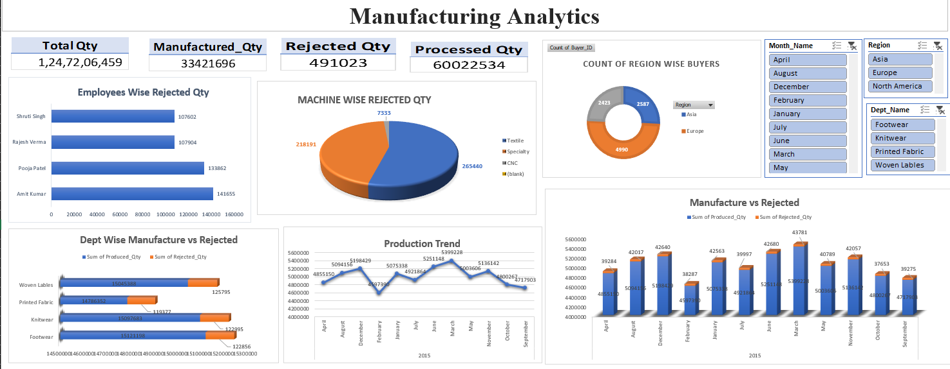
Excel Dashboard

Slide 16
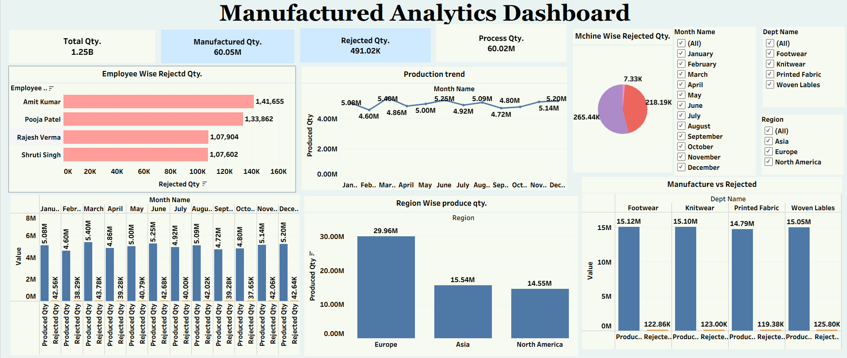
Tableau Dashboard

Slide 17
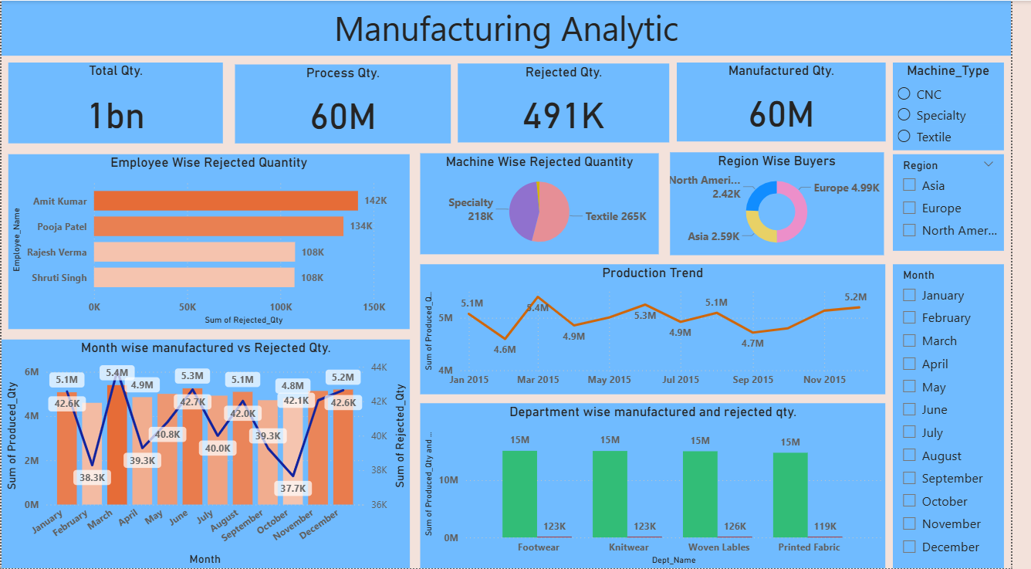
Power Bi Dashboard

Slide 18
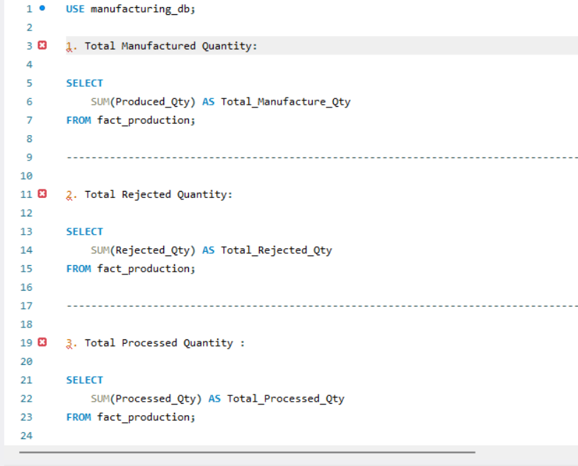
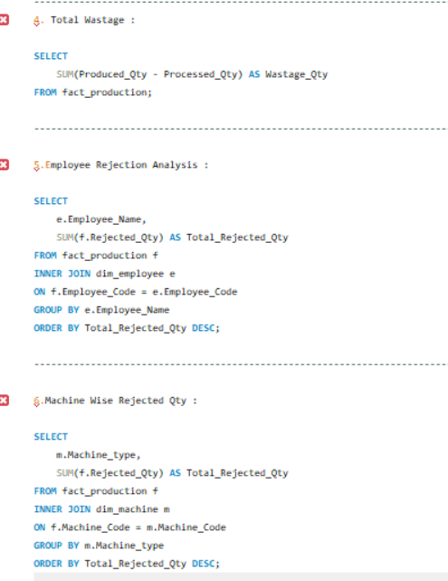
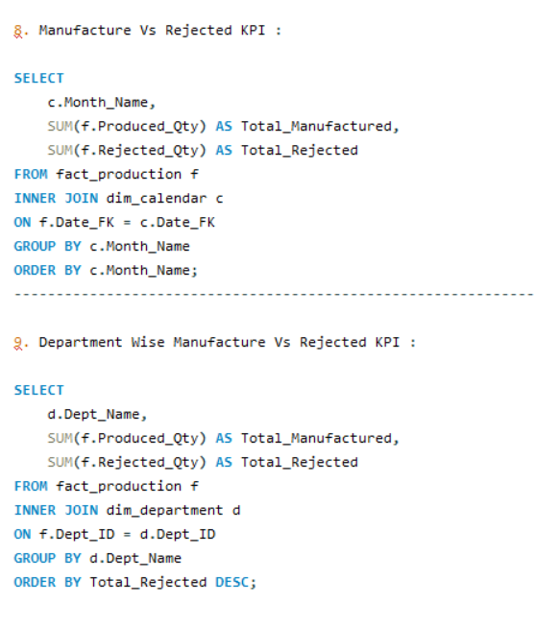
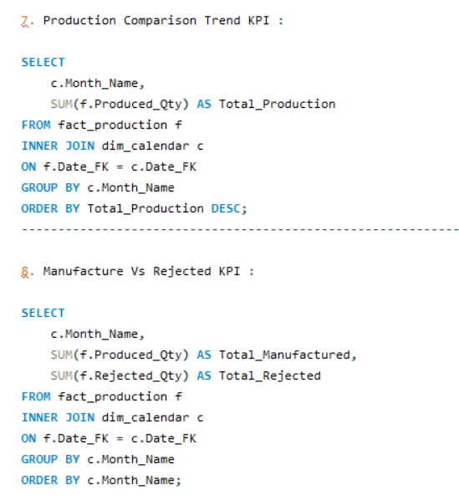
SQL Queries

Slide 19
Thank You

